Slide 1
Speed up your Angular App with Web Workers

Slide 2

Module Overview
Isn’t JavaScript Inherently Concurrent?
A Web Worker for JavaScript Concurrency
Setting up the Angular App
Our First Angular App From CLI
Add a Random Circle Component Using the Angular CLI
Adding an Angular Web Worker
LongLoop in the Web Worker
Wrapping Up Angular Apps with Web Workers

Slide 3
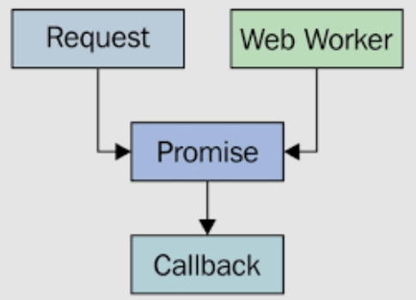
Isn’t JavaScript Inherently Concurrent?

Slide 4
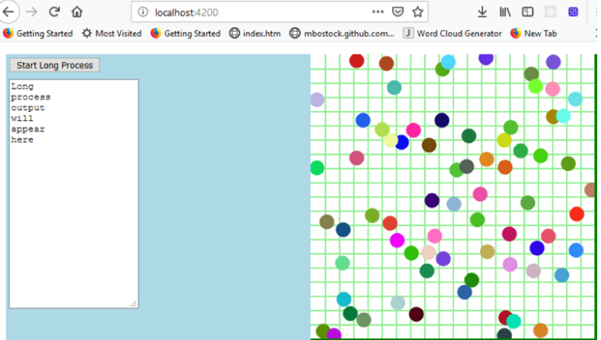
A Web Worker for JavaScript Concurrency

Slide 5
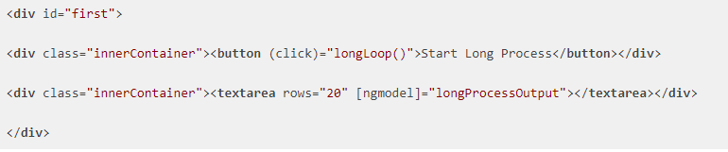
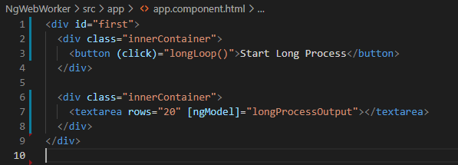
Our First Angular App From CLI

Slide 6

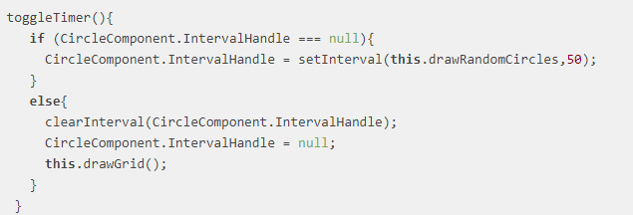
Add a Random Circle Component Using the Angular CLI

Slide 7
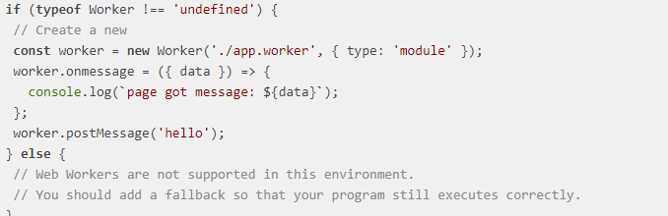
Adding an Angular Web Worker

Slide 8
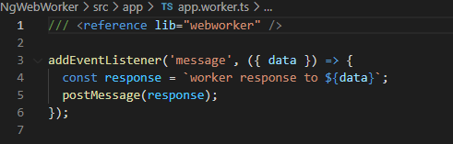
Adding an Angular Web Worker

Slide 9
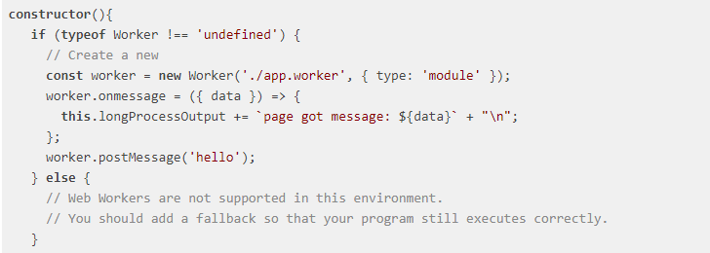
Adding an Angular Web Worker

Slide 10
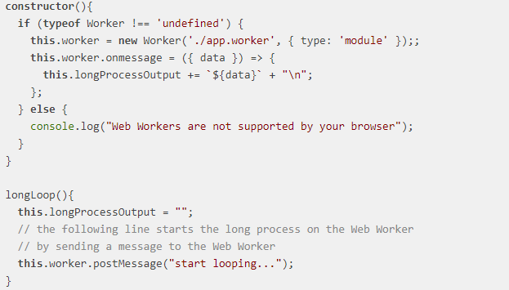
Adding an Angular Web Worker

Slide 11
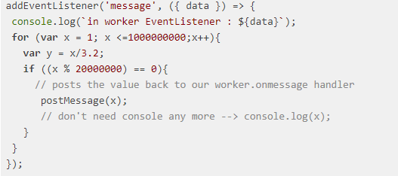
app.worker.ts revisited

Slide 12
Wrapping Up Angular Apps with Web Workers
Now when you run the app, you will find that clicking the [Start Long Process] button no longer causes the circle drawing to pause.
You will also be able to directly interact with the circle-drawing Canvas component so that, if you click it while longLoop is still running, the Canvas will be redrawn immediately. Previously, the app behaved as if it were frozen if you did this.
Now you can add your long running processes to an Angular Web Worker and reap all the benefits of an app that doesn’t freeze.
If you want to see an example solved with JavaScript Web Workers you can see it at Plunker.

